Slide 1

CEIR System Management -Training Manual

Slide 2

Agenda
Feature Overview
Deployment Overview
Configuration Items
UI Walk Thru
Message Management
Field Management
Port Management
System Management
Audit Management
Currency Management
Policy Management

Slide 3

Feature Overview
System Management Feature allows System admin to configure the user related parameters in the CEIR system.
This feature is available to system admin.
Typical flow is as follows:
System Management
System Admin login into the portal
System Admin access a system configuration feature
System admin configure the a given feature like messages
All the changes are effective from the next use onwards
System User
Add, View, Edit
CEIR System

Slide 4
Feature Impact / Use Cases
Importance of this feature for the CEIR System
This feature is one of the key feature in the system.
This allow system admin to configure the system.

Slide 5
Configuration - Items
Item | Description
Message Management | All the Email and SMS message sent to the stakeholder and end users can be configured using this interface
Port Management | All the custom ports and address can be configured using this interface
User Parameters (System Management) | All user parameter can be configured using this interface
System Parameters (System Management) | All system parameter can be viewed. These parameter are not to be changed or edited
Field Parameters (Drop down field in form and files) | All values shown in the drop down menu in the UI panel for various user can be configured using this panel

Slide 6
Configuration – Items – Contd …
Item | Description
Policy Management | All policy related parameter can be defined in this interface
Audit Management | To view what users are doing and which functionality is being used.
Currency Management | Configure the prices of different currency in Riel and Dollar on monthly basis

Slide 7
System Admin User – System Interface

Slide 8
Message Management
All Email and SMS message/Notifications are configured using this feature
Filter can be set on
Channel Type (SMS/E mail)
Each message is dynamic and contain following dynamic parameters depending on the message:
First name of the stakeholder for addresing the mail (f_name)
Transaction ID of the request (txn_id)
User Name (u_name)
Any change will come into effect from the next request generated in the system.

Slide 9
Message Management – Examples - Consignment
Message sent to Importer when system has rejected the consignment due to processing errors
Message sent to CEIR Authority when system has processed the consignment successfully
Message sent to Importer when CEIR Authority has been rejected the consignment
Message sent to Importer when system has processed the consignment successfully
Message sent to CEIR Authority when custom has processed the consignment successfully
Message sent to Importer when Customs has processed the consignment successfully
Message sent to Importer when Customs has rejected the consignment
Message sent to CEIR Admin when Customs has rejected the consignment
Message sent to Importer or TRC when system has processed the type approval request successfully

Slide 10
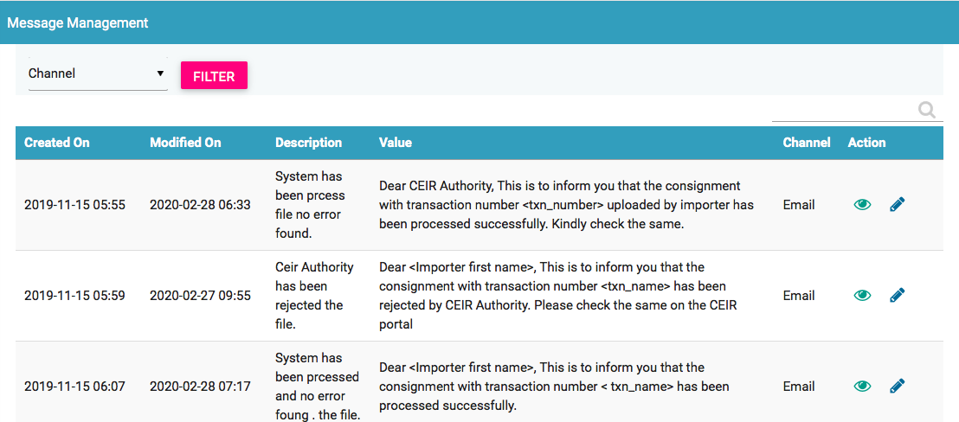
Message Management - GUI

Slide 11
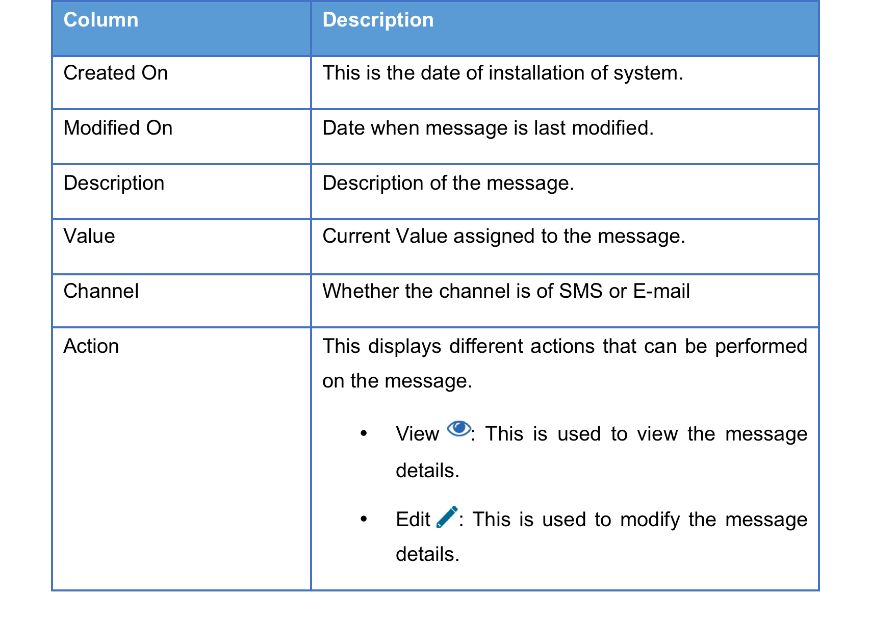
Message Management - GUI

Slide 12
System Management
All User Related parameters are configured using this feature
Filter can be set on
Parameter Type (User/System)
System parameter are not allowed to be changed and is only for view purpose.
User Parameter can be changed.
Any change will come into effect from the next request generated in the system.

Slide 13
System Management – Examples – Greylist
Time Period in days after which the Full Greylist file would be generated in the CEIR system
Time Period in days after which the Incremental Greylist file would be generated in the CEIR system
Day of the Week on which Greylist or Blacklist will be generated by CEIR system. This parameter is valid only when frequency is weekly (7 days).
Base Path from where full and incremental Greylist file would be maintained in the CEIR system
Period in days when the IMEI will move from Greylist to blacklist in the CEIR system
Base URL from where full and incremental Greylist file would be available for download by operator from the CEIR system

Slide 14
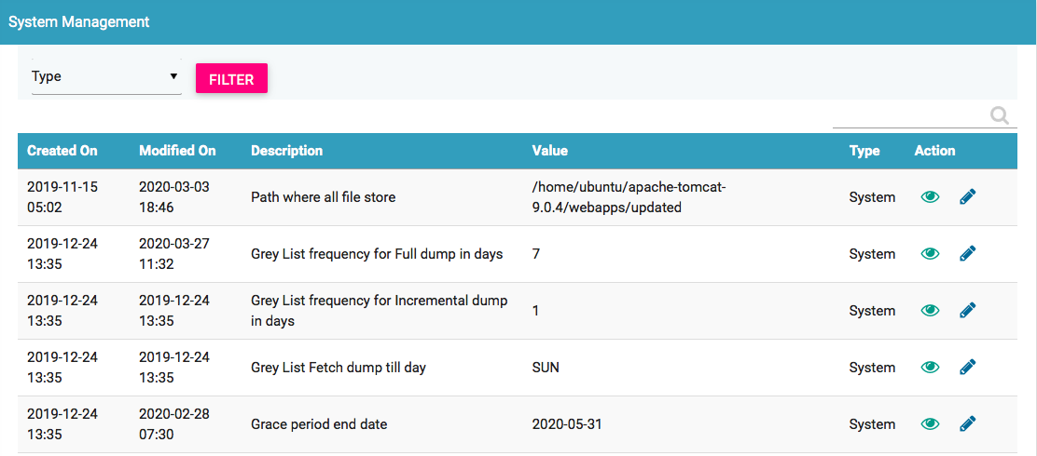
System Management - GUI

Slide 15

System Management - GUI

Slide 16
Port Management
All custom port can be configured using this feature
Filter can be set on
Port Type (Water/Air/Land)
Once port is configured, it can be viewed in the custom registration portal

Slide 17
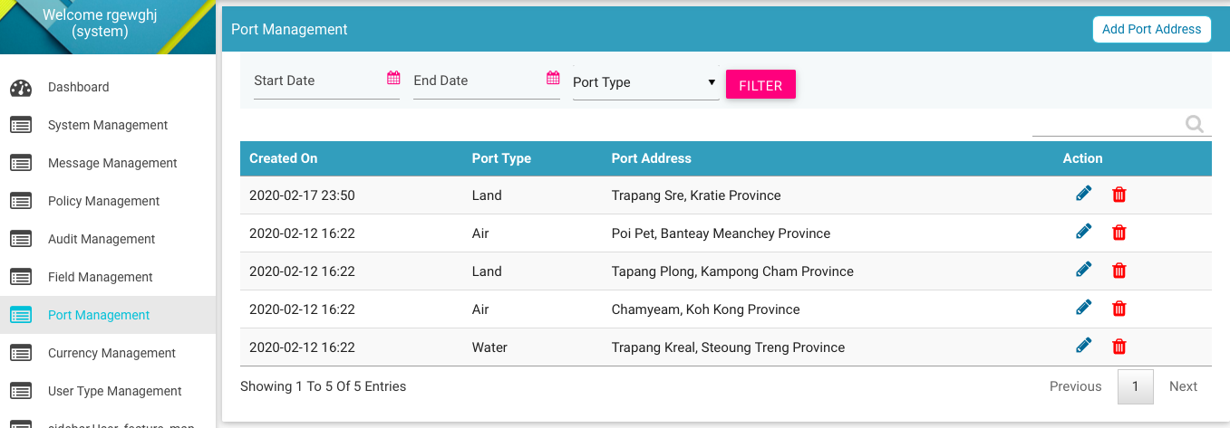
Port Management - GUI

Slide 18
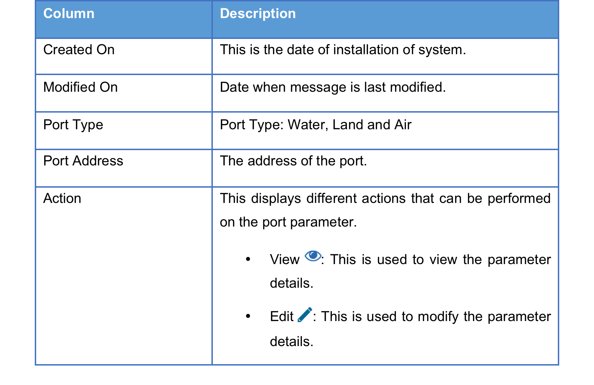
Port Management - GUI

Slide 19
Field Management
All field related parameters are configured using this feature
Field parameters are of different types:
File Fields in the input file as uploaded by stakeholder. For example, importer uploads a file while registering the consignment. The file contains various fields like device type.
Form Field that is shown in the form as displayed to the user. For example, the custom registration form has drop down to list down all the port types like water, land and air.
Status Field that is shown in the various filters in the form. For example, there are various status of the consignment like NEW, PROCESSING etc. The system contain a state logic based on these field values.
System Fields that are shown in the various views in form of tables field values. For example, the alert can be raised or cleared. The value for same is displayed
Any change will come into effect from the next request generated in the system.

Slide 20
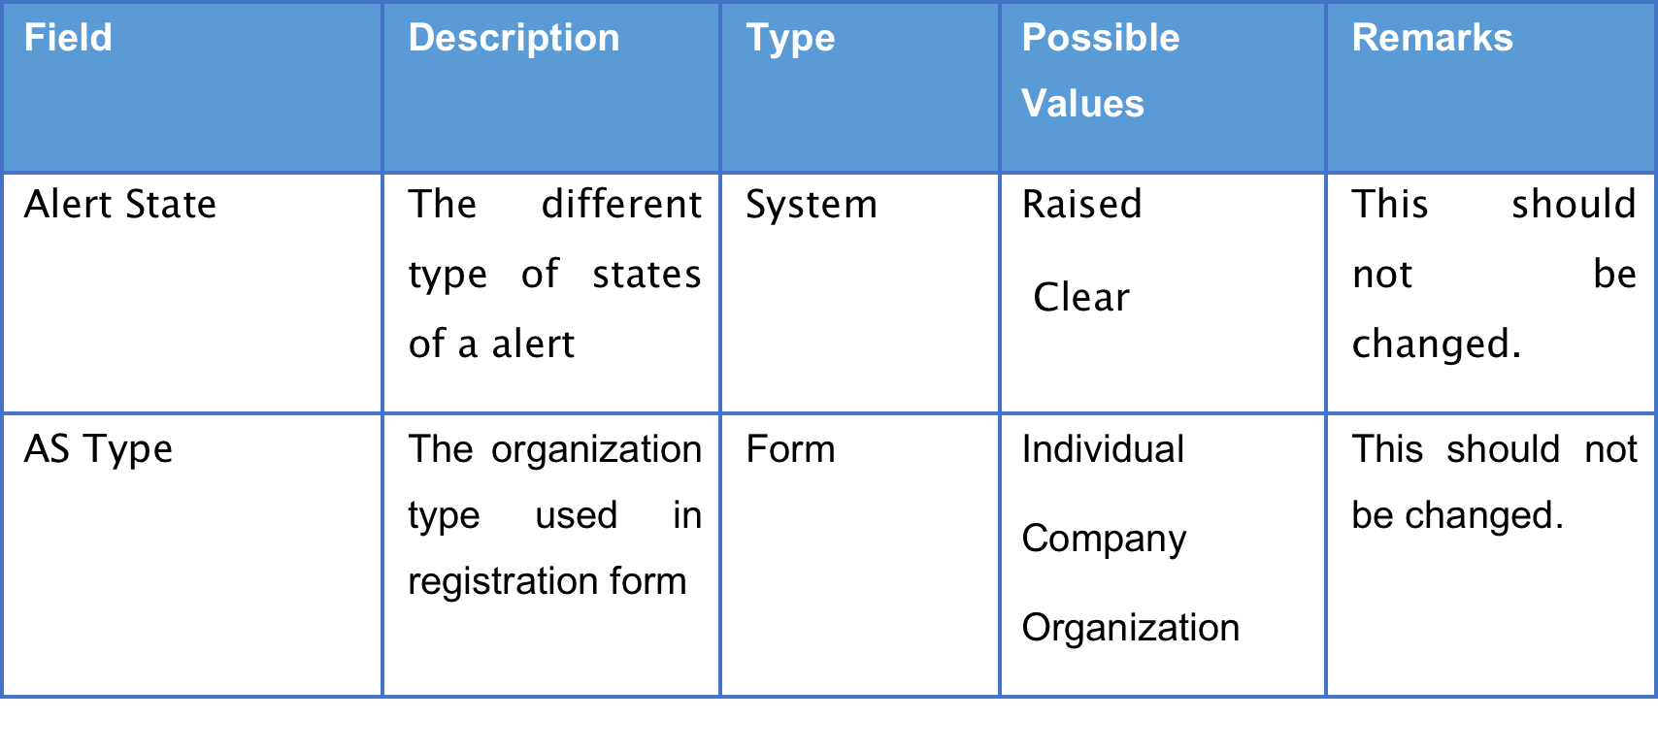
Field Management – Examples

Slide 21
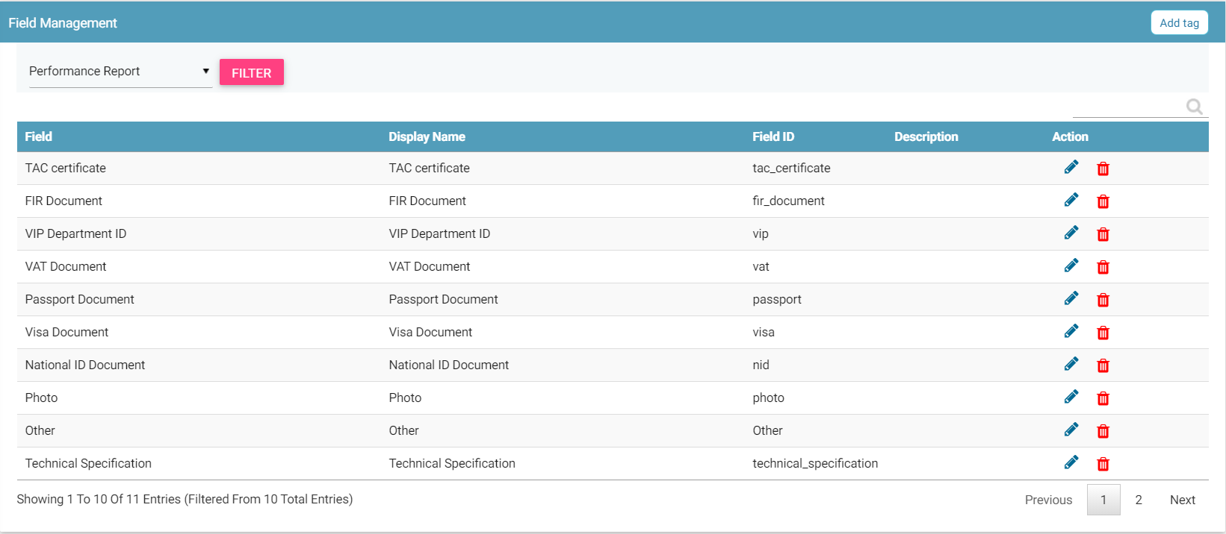
Field Management - GUI

Slide 22
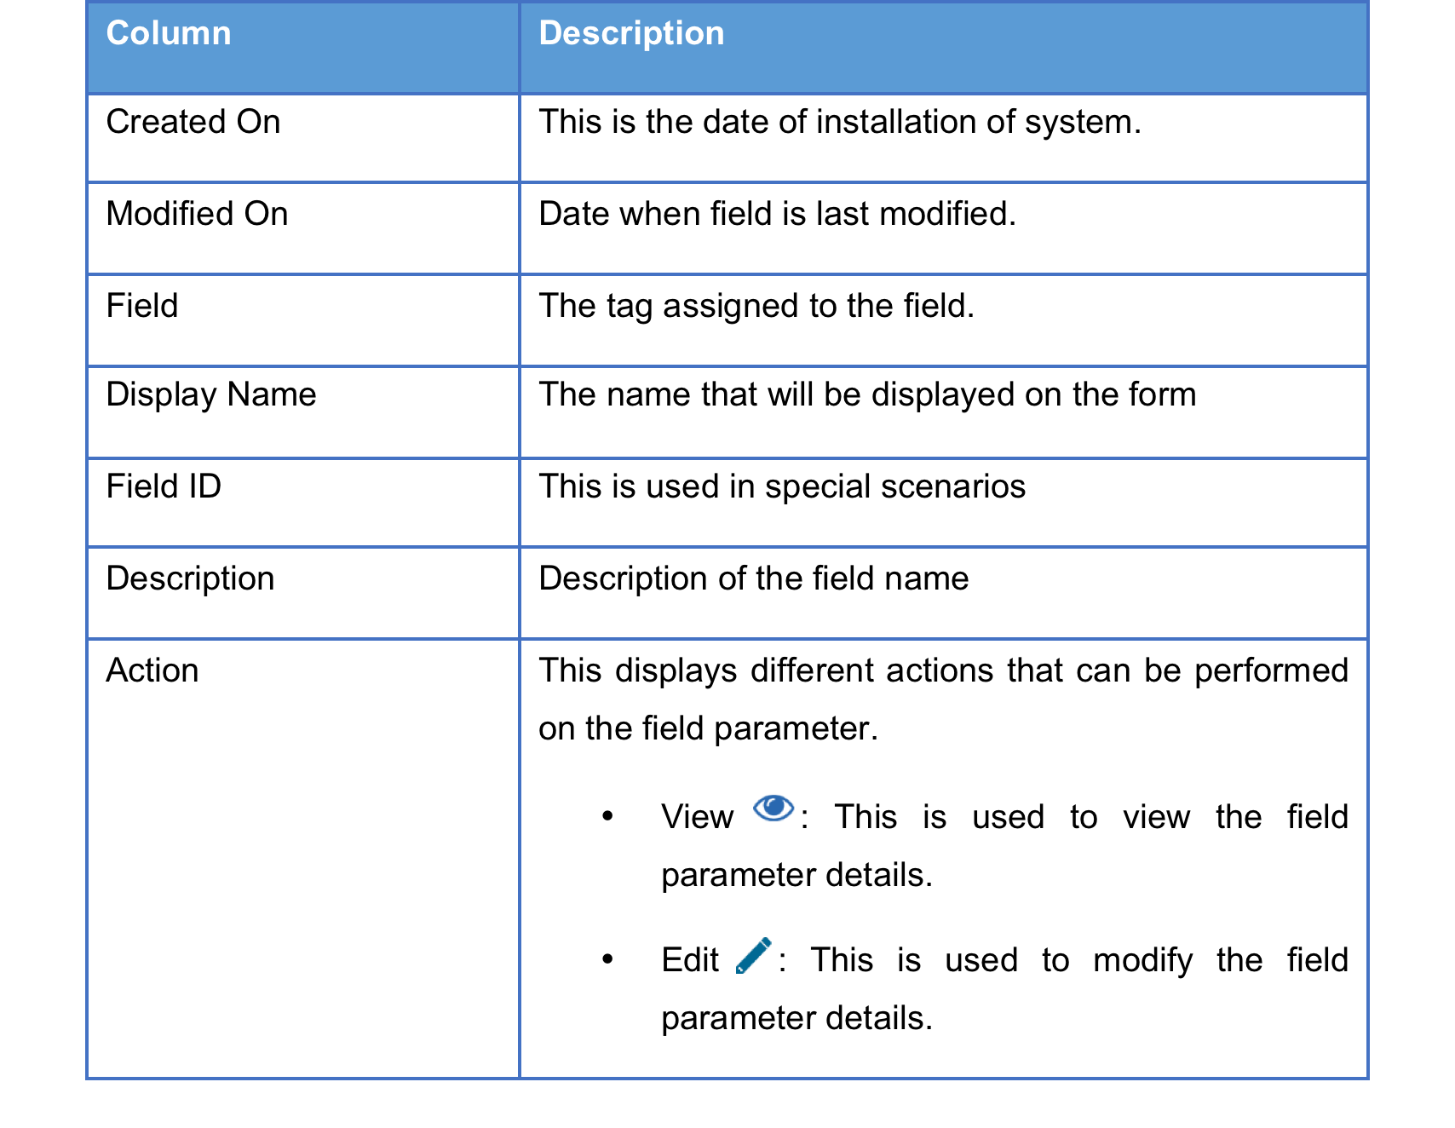
Field Management - GUI

Slide 23
Currency Management
To configure the currency rate on monthly basis for all supported currency in the CEIR system.
The list of supported currency is defined in the Currency field using “Field Management” Feature.
The currency rate are used for generating revenue reports in the system

Slide 24
Currency Management – Examples
For example, if the currency is Euro, then the conversion rate is mentioned as follows
Value in Cambodian Riel is 4535.52 as 1 Euro is equal to 4535.52 Cambodian Riel
Value in Dollar is 1.12 as 1 Euro is equal to 1.12 US Dollar.

Slide 25
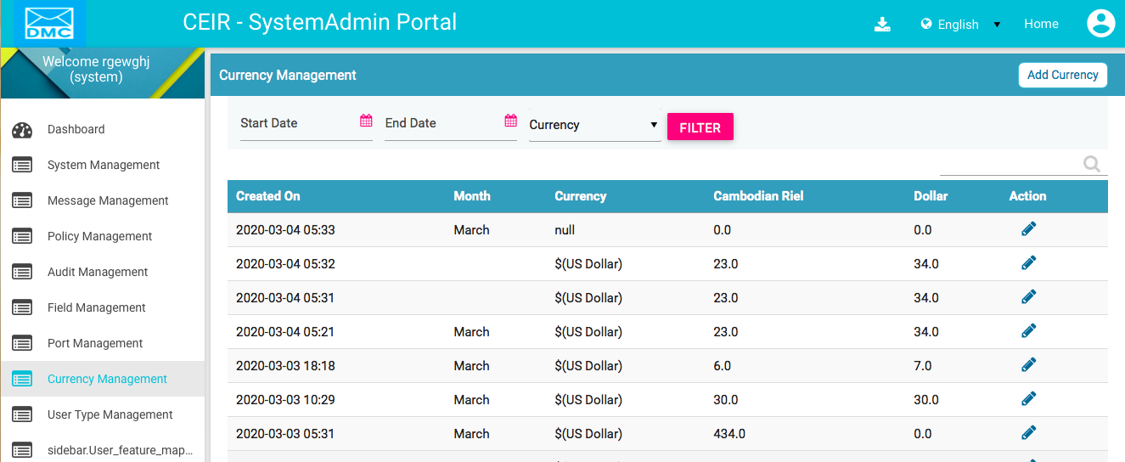
Currency Management - GUI

Slide 26
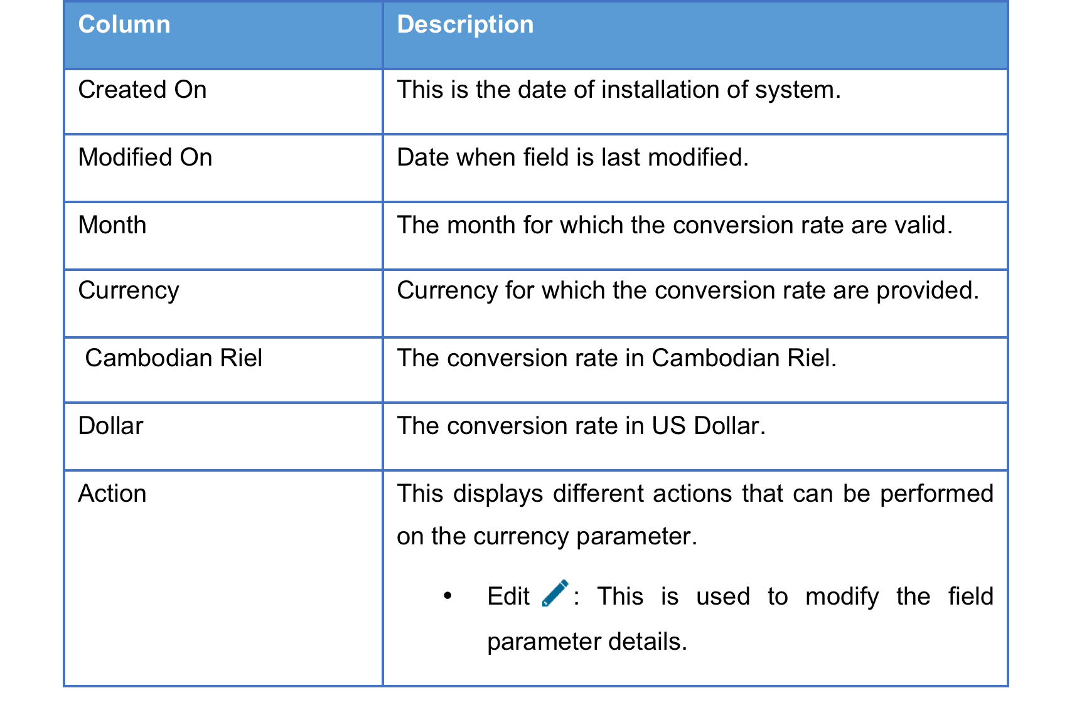
Currency Management - GUI

Slide 27
Audit Management
Logging of all user related activity.
When the user does any key activity like register consignment, upload stock, login, logout, all such request are logged into the system.

Slide 28
Audit Management – Examples
Importer views a consignment
Importer logins into the system
System Admin views the configuration parameter
End user registers a device
Custom view a device
Retailer uploads a stock
Distributor raises a grievance
CEIR Admin approves a consignment

Slide 29
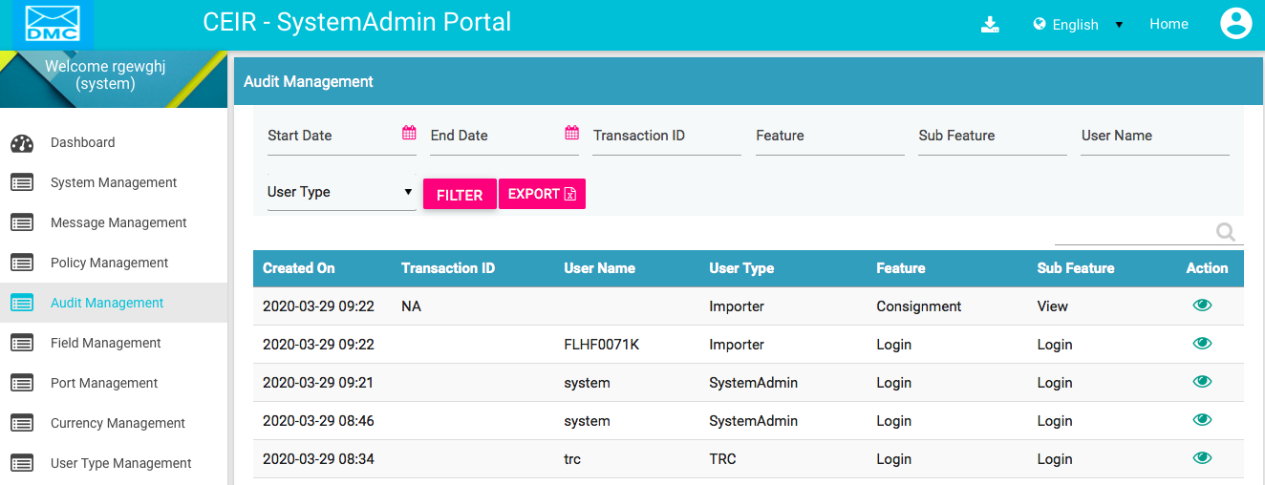
Audit Management - GUI

Slide 30
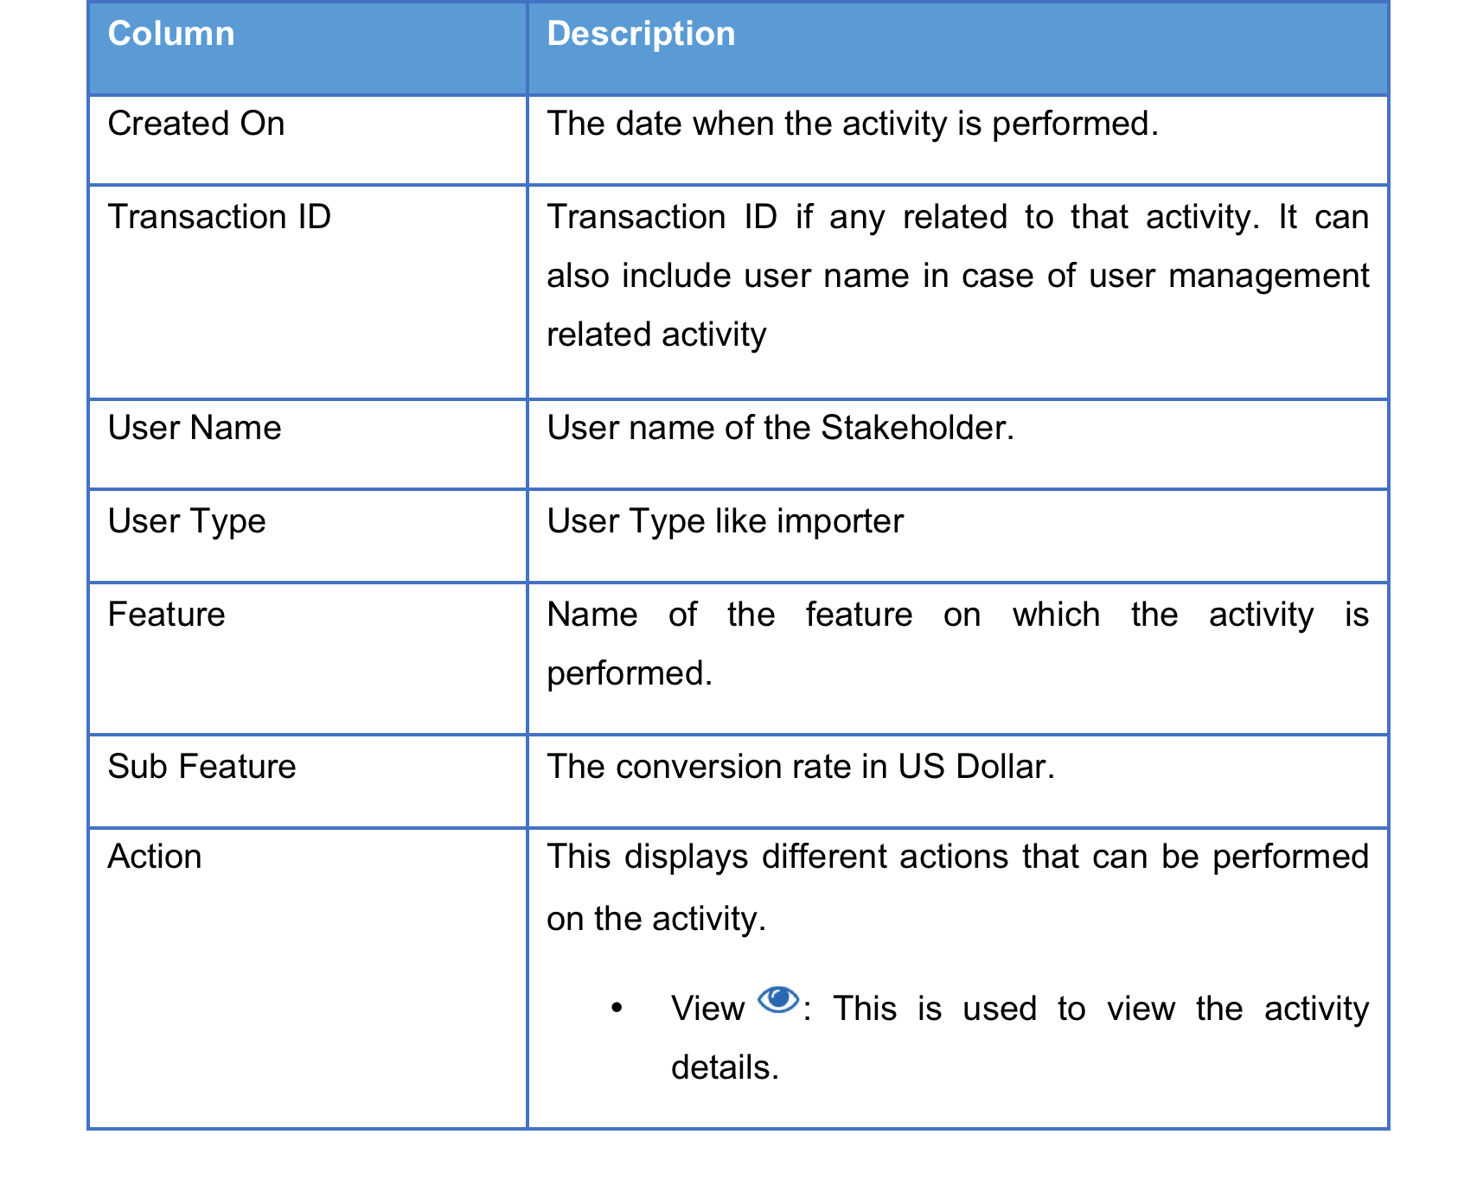
Audit Management - GUI

Slide 31
Policy Management
All policy related are defined using this feature.
These parameter would be communicated to the user/stakeholders.

Slide 32
Policy Management – Examples
Number of devices allowed to Cambodian user while coming back to Cambodia
Number of devices allowed to Foreigner user while coming to Cambodia in one visit

Slide 33
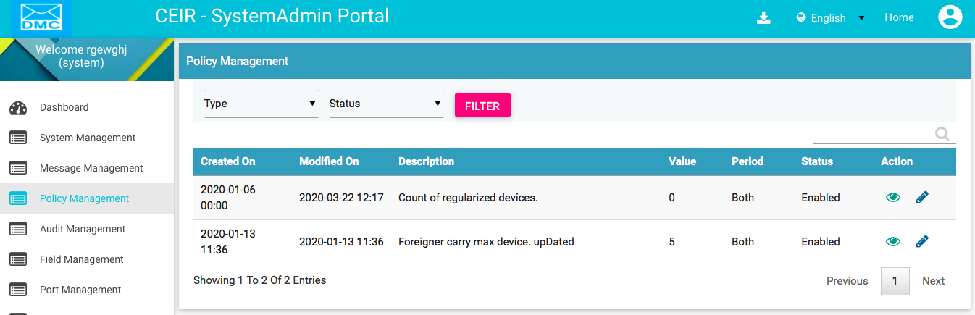
Policy Management - GUI

Slide 34
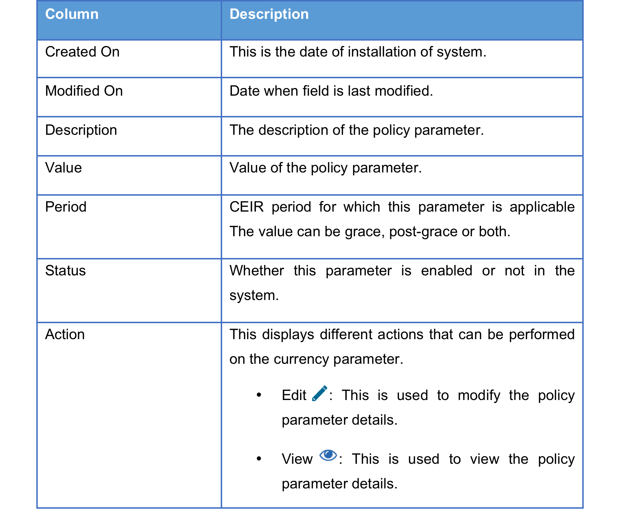
Policy Management - GUI

Slide 35
User Type Management
Display all the user Type
User Type denote a category of user.
Example
Importer is a user type
Distributor is a user type
When a importer is created, it is attached to a user type. To each user type, a set of functionality/feature is attached.

Slide 36
User Type – Types
Importer
Distributor
Retailer
Manufacturer
TRC
Custom
Operator
Immigration
End User – VIP, Foreigner, Cambodian User
Anonymous User
Customer Care
System Admin
CEIR Admin
Operations
User Type is two types:
External
Internal
External
External User Type is created by user using self registration option
Internal user Type is created by CEIR Admin user
Internal

Slide 37
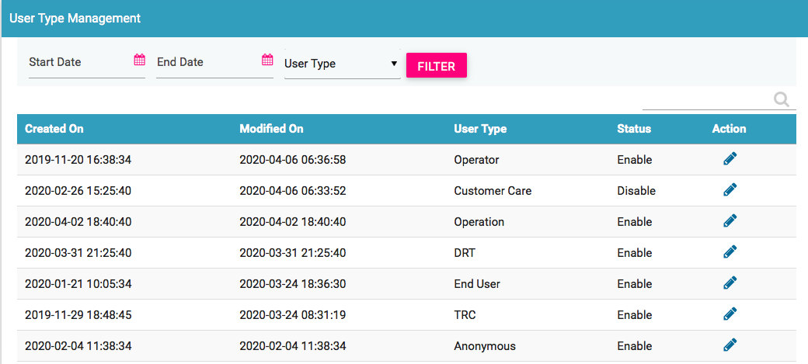
User Type Management - GUI
Only External User Type is displayed

Slide 38
User Type Management - GUI
If Status is enabled, then only this user type will work in the system.
If status is disabled, this user type will stop working in the system. For example if the user type as distributor is disabled, then no more new registration will happen, existing distributor will not be able to login
If custom user type is disabled, and new consignment comes, then it will be auto approved from the custom role as the user is disabled and the functionality should work and consignment should be approved.

Slide 39
User Type Feature Mapping –
Display all the feature assigned to the given user type. Feature represent functionality assigned to the user type
All assigned feature are shown on the left panel of the GUI when the user logs into the portal
Feature can be assigned based on the period.
Period is one of the 4 options
Period | Remarks
Grace | This feature will only be displayed to user type in grace period
Post Grace | This feature will only be displayed to user type in post grace period
Both | This feature will only ALWAYS be displayed to user type
None | This feature will only NOT be displayed to user type

Slide 40
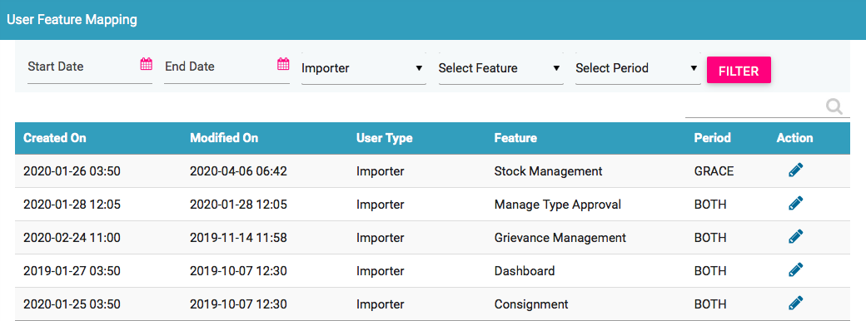
User Feature Mapping Management - GUI
Only Importer user type is selected

Slide 41
User Feature Mapping - GUI
Period can be modified for the a given user type

Slide 42
Rule List
Display all the rule defined in the system
Rule will be applied when the user request like upload stock, register consignment, stolen request is processed by the system processes
Rule can be assigned based on the states.
State is one of the 3 options
So for CDR processing,
only rule as defined as FULL
will be executed
So for other request ,
only rule as defined as FULL
and PARTIAL will be executed
State | Remarks
Disabled | This rule is disabled and not be applied
Partial | This rule will only be applied in few functionality. This is applied in all functionality minus CDR processing
Full | This rule is applied for all functionality.

Slide 43
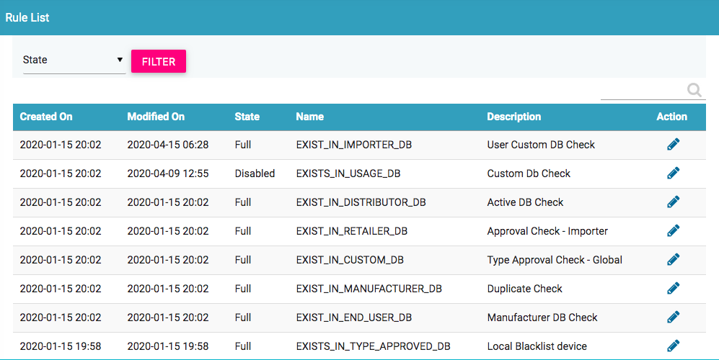
Rule List Management - GUI
Display the rule

Slide 44
Rule List - GUI
State and Description about the given rule name can be modified

Slide 45
Rule Feature Mapping
Display all the rule which are mapped the to the feature in the system
Rule will be applied when the user request like upload stock, register consignment, stolen request is processed by the system processes
Rule can be assigned based on the feature and user type.
If same set of rule applied to all user type for a given feature, the value of user type is default to denote it applies to all user type

Slide 46
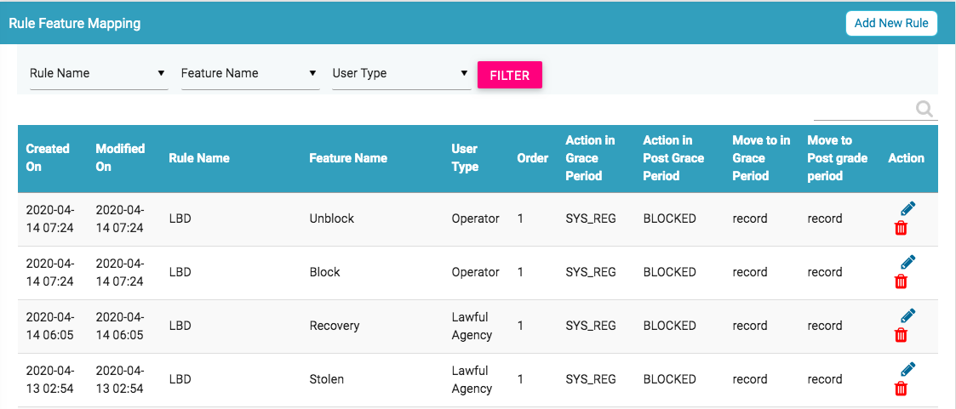
Rule Feature Mapping - GUI
Display the rule

Slide 47
Rule Feature Mapping - GUI

Slide 48
Rule Feature Mapping – GUI – Contd…

Slide 49
Queries

Slide 50
Thank You

